Slide 1


N C
A co-operative R & RStudio coding group within NRC
Jenna MacKinnon
jenna.mackinnon@nrc-cnrc.gc.ca
Solenn Mordret
solenn.mordret@nrc-cnrc.gc.ca
Lesson N°3

Slide 2
Schedule
Introduction to Data Visualization 08-JUN-2022
Basic plots, Intro to ggplot2
Advanced Graphing with ggplot2 22-JUN-2022
Scatter plots, line graphs, bar graphs
Introduction to Statistics 06-JUL-2022
ANOVAs, GLMs, etc.
Advanced Graphing and Statistics 20-JUL-2022
Multivariate analyses, PCAs
Advanced Graphing and Statistics 03-AUG-2022
Heatmaps, phylogenetic trees

Slide 3
Schedule for future courses
Basic Predictive Analysis & Modelling 17-AUG-2022
Spectral Data Processing & Binning 31-AUG-2022
Any other ideas?
What kind of data are you generally working on?
Send us your dataset with some explanation

Slide 4
Summary & Assessment
How is the course going so far?
Are we going too fast / too slow?
How many people executed every single script without any issues? Produced all figures?
Do you find the nRc group useful?
Were you able to start creating your own script?

Slide 5
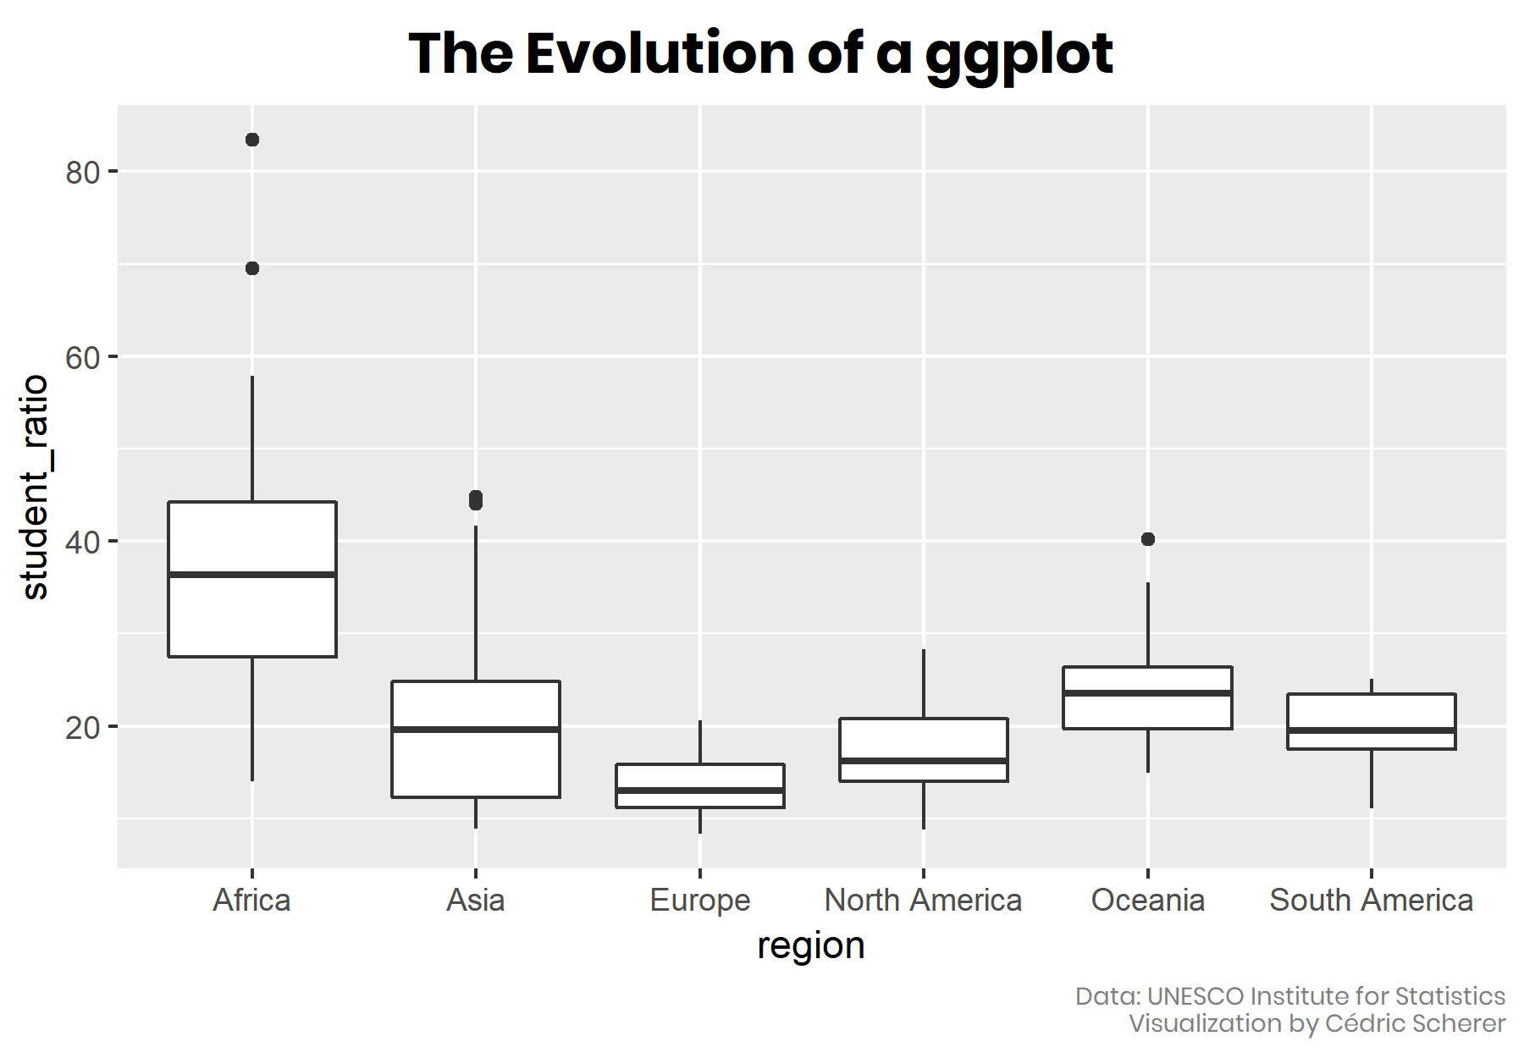
Introduction to Data Visualization Basic plots, Intro to ggplot2 08-JUN-2022

Slide 6
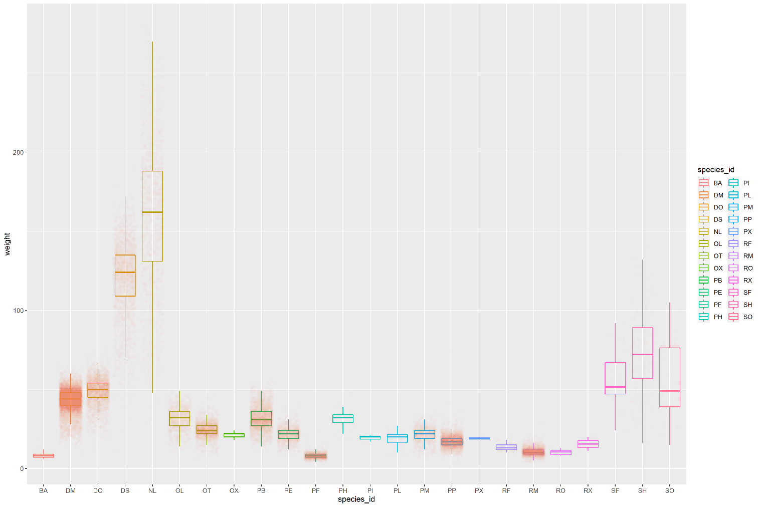
Introduction to Data Visualization Basic plots, Intro to ggplot2 08-JUN-2022
Homework from last week

Slide 7
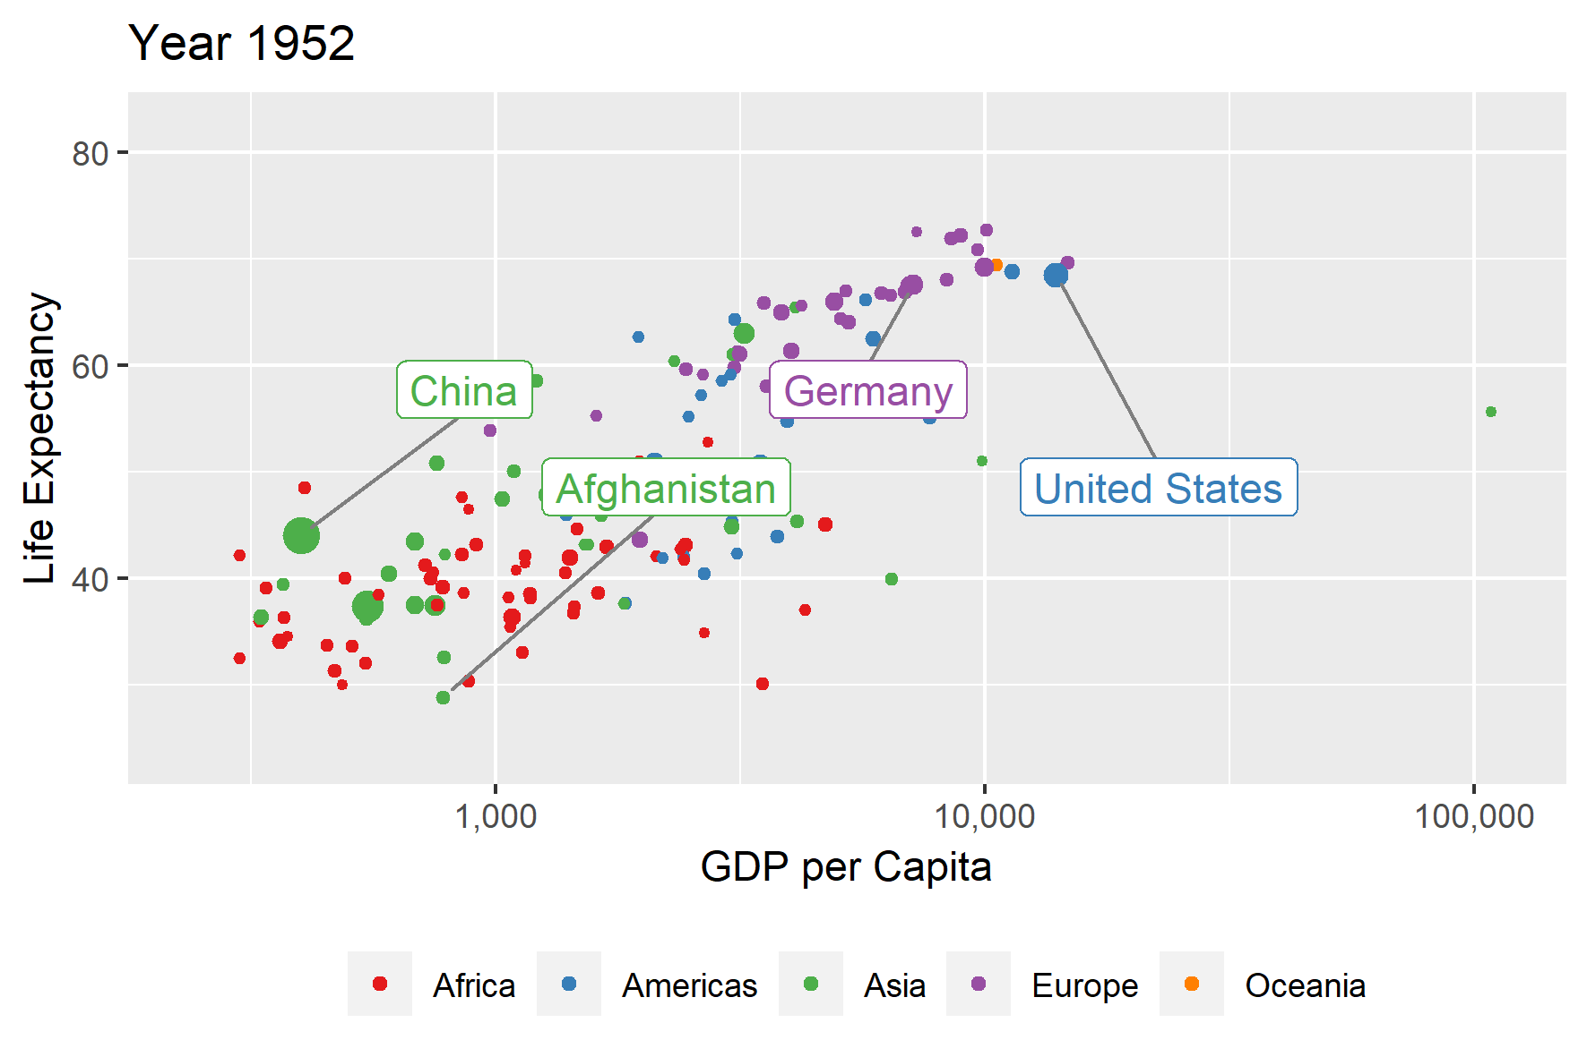
Advanced Graphing with ggplot2 Scatter plots, line graphs, bar graphs
22-JUN-2022

Slide 8
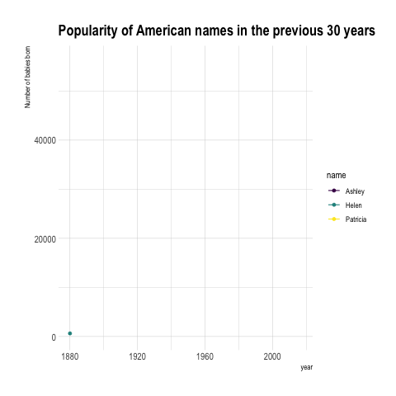
Advanced Graphing with ggplot2 Scatter plots, line graphs, bar graphs
22-JUN-2022

Slide 9
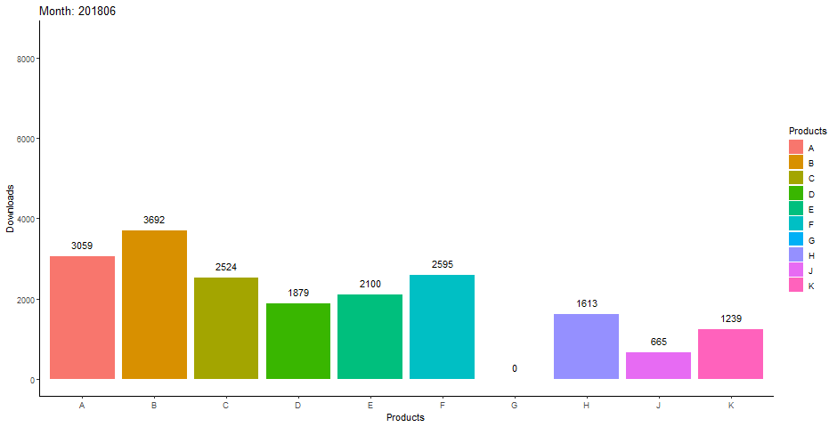
Advanced Graphing with ggplot2 Scatter plots, line graphs, bar graphs
22-JUN-2022

Slide 10
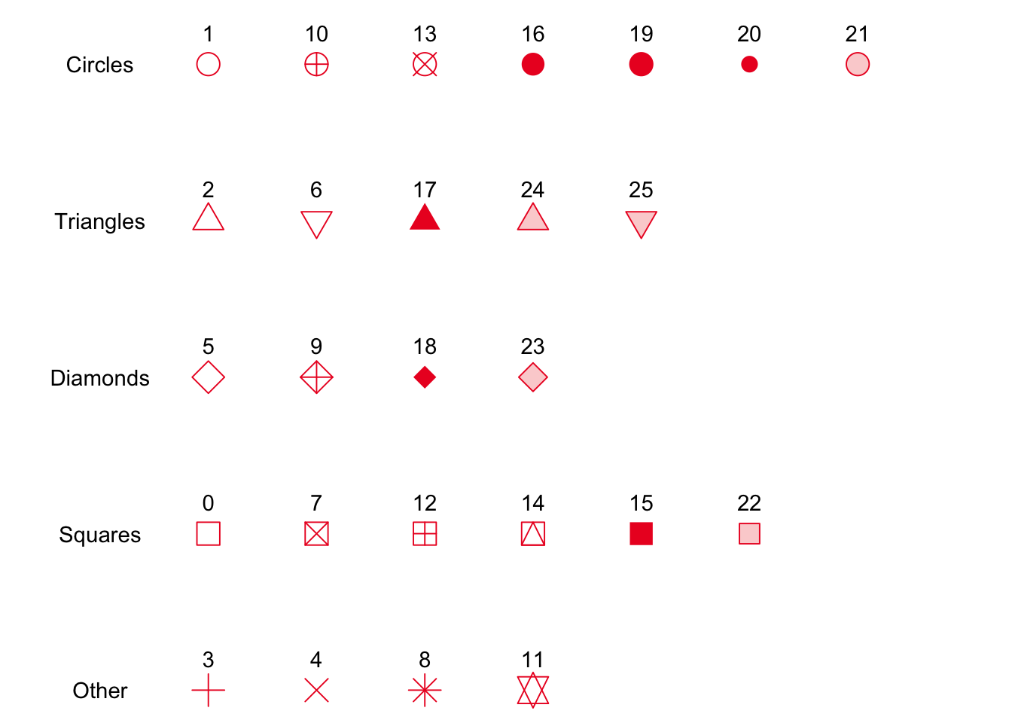
Advanced Graphing with ggplot2 Scatter plots, line graphs, bar graphs
22-JUN-2022
Simple codes for type of points in R:

Slide 11
Useful links
Today’s links:
ggplot2 : : CHEAT SHEET
data-visualization-2.1 (usyd.edu.au)
R colour palettes
Slide 1 (ucsb.edu)
HTML colours generator
HTML Color Picker (w3schools.com)
HTML Color Codes Chart 🎨 (rapidtables.com)

Slide 12
Useful links
Today’s course was inspired from:
The Evolution of a ggplot (Ep. 1) - Cédric Scherer (cedricscherer.com)
https://www.cedricscherer.com/2019/05/17/the-evolution-of-a-ggplot-ep.-1/
From data to Viz | Find the graphic you need (data-to-viz.com)
https://www.data-to-viz.com/
The R Graph Gallery – Help and inspiration for R charts (r-graph-gallery.com)
https://r-graph-gallery.com/

